Slide 1
Wholesale Price List
Rexing Inc.

Slide 2
Order Placement
Sign the Wholesale Agreement
Request for additional quote
Model Number
Quantity (wholesale MOQ is 30 units)
Shipping Address
Shipping Account Number (if any)
Advanced Payment
Advanced Payment is required for shipment
Do NOT accept checks
≤$2000, Credit Cards ONLY
≥$2000, Bank Transfers ONLY

Slide 3
Wholesale Price List
Dash Cams

Slide 4
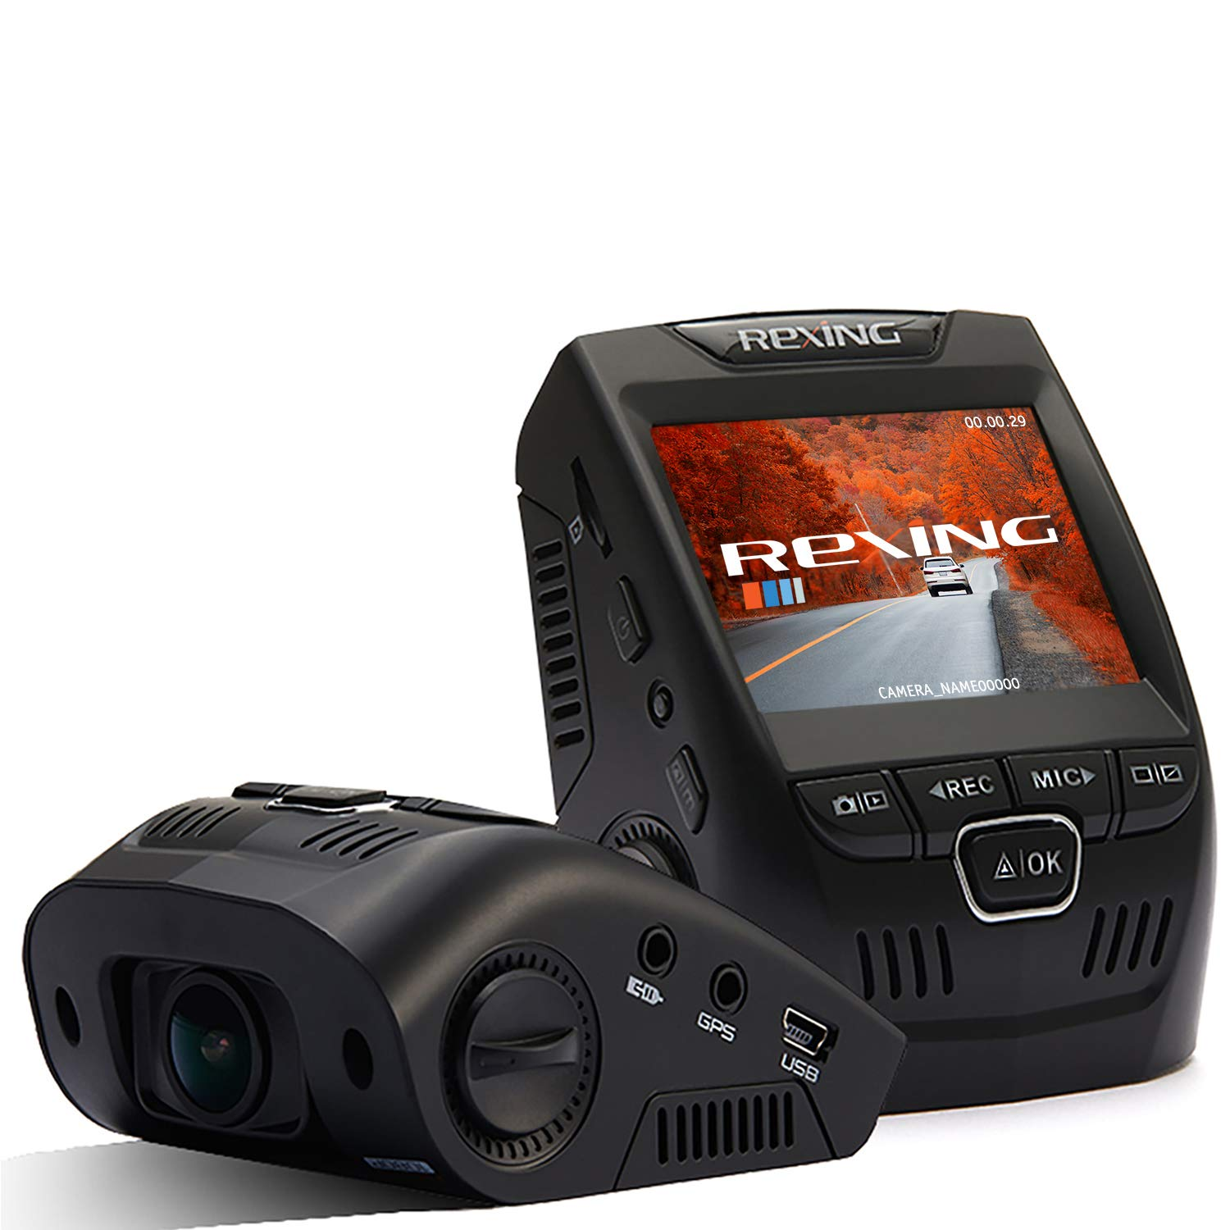
Rexing V1 Basic
$44.99
Single Channel Dash Cam
Full HD 1080P Resolution
2.4” LCD Screen
170° Wide Angle
G-Sensor
Parking Monitor
Loop Recording
Discreet Design

Slide 5
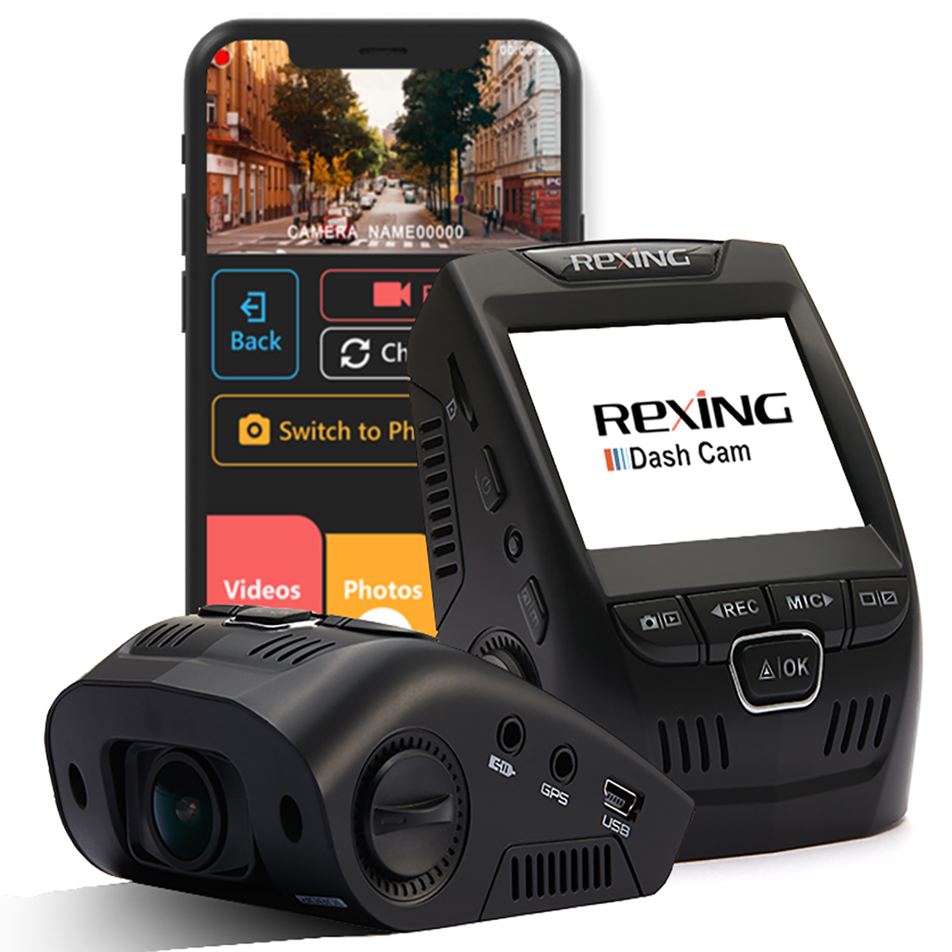
Rexing V1-4K
$79.99
Rexing Best Selling Product
Single Channel Dash Cam
Ultra HD 2160P Resolution
2.4” LCD Screen
G-Sensor & Parking Monitor*
Wi-Fi Connectivity
Loop Recording
Supercapacitor
*Parking monitor feature required Rexing Smart Hardwire Kit (sold separately) to be activated.

Slide 6
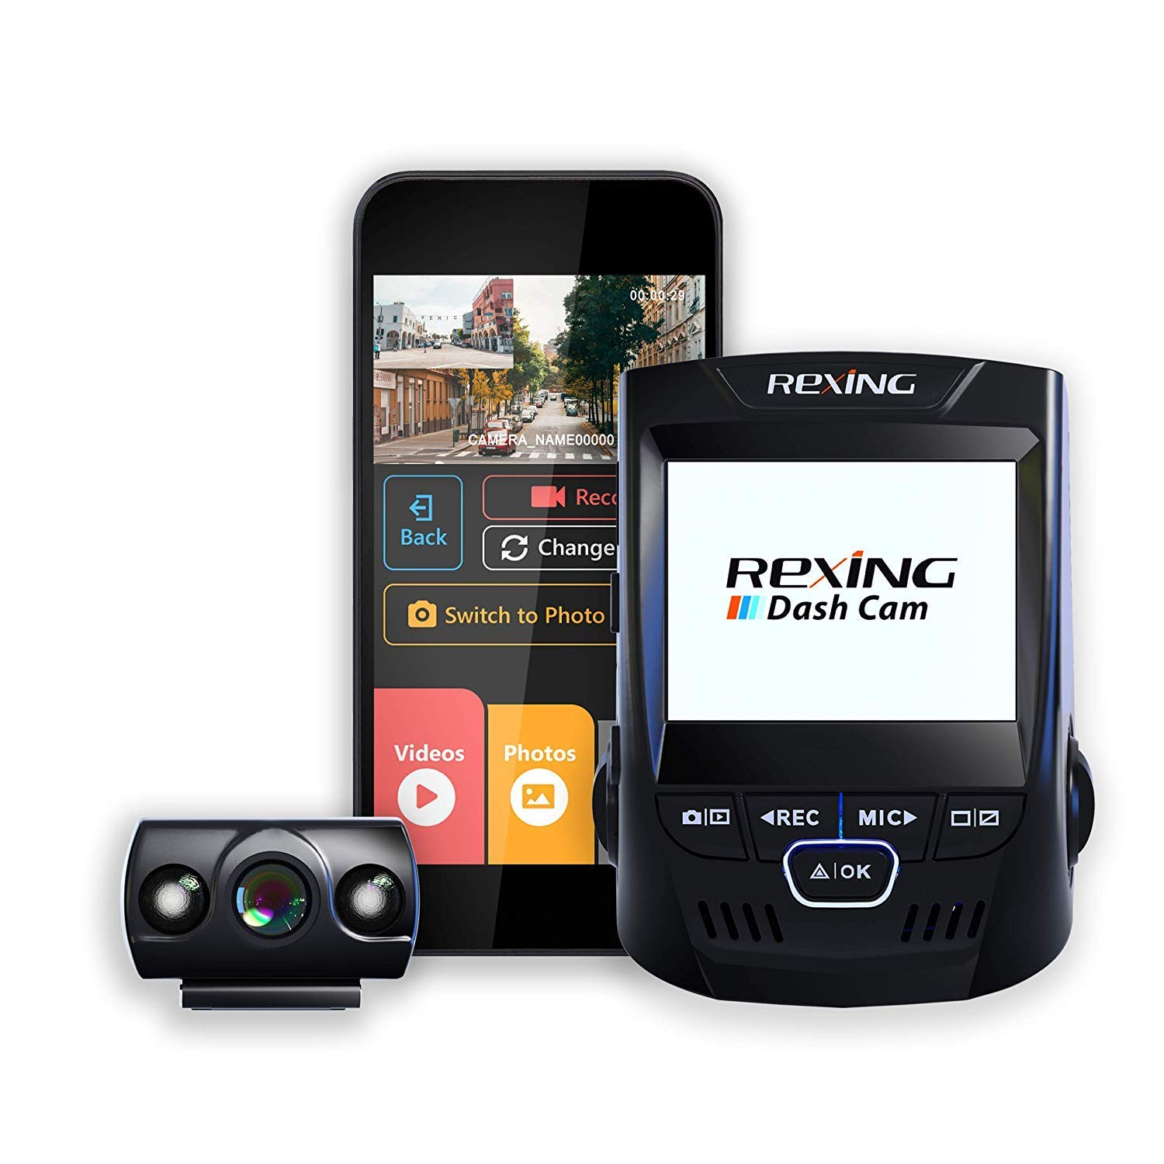
Rexing V1P
$103.99
Front And Rear Dash Cam
Full HD 1080P Resolution
2.4” LCD Screen
170° Wide Angle
G-Sensor & Parking Monitor*
Wi-Fi Connectivity
Loop Recording
Supercapacitor
*Parking monitor feature required Rexing Smart Hardwire Kit (sold separately) to be activated.

Slide 7
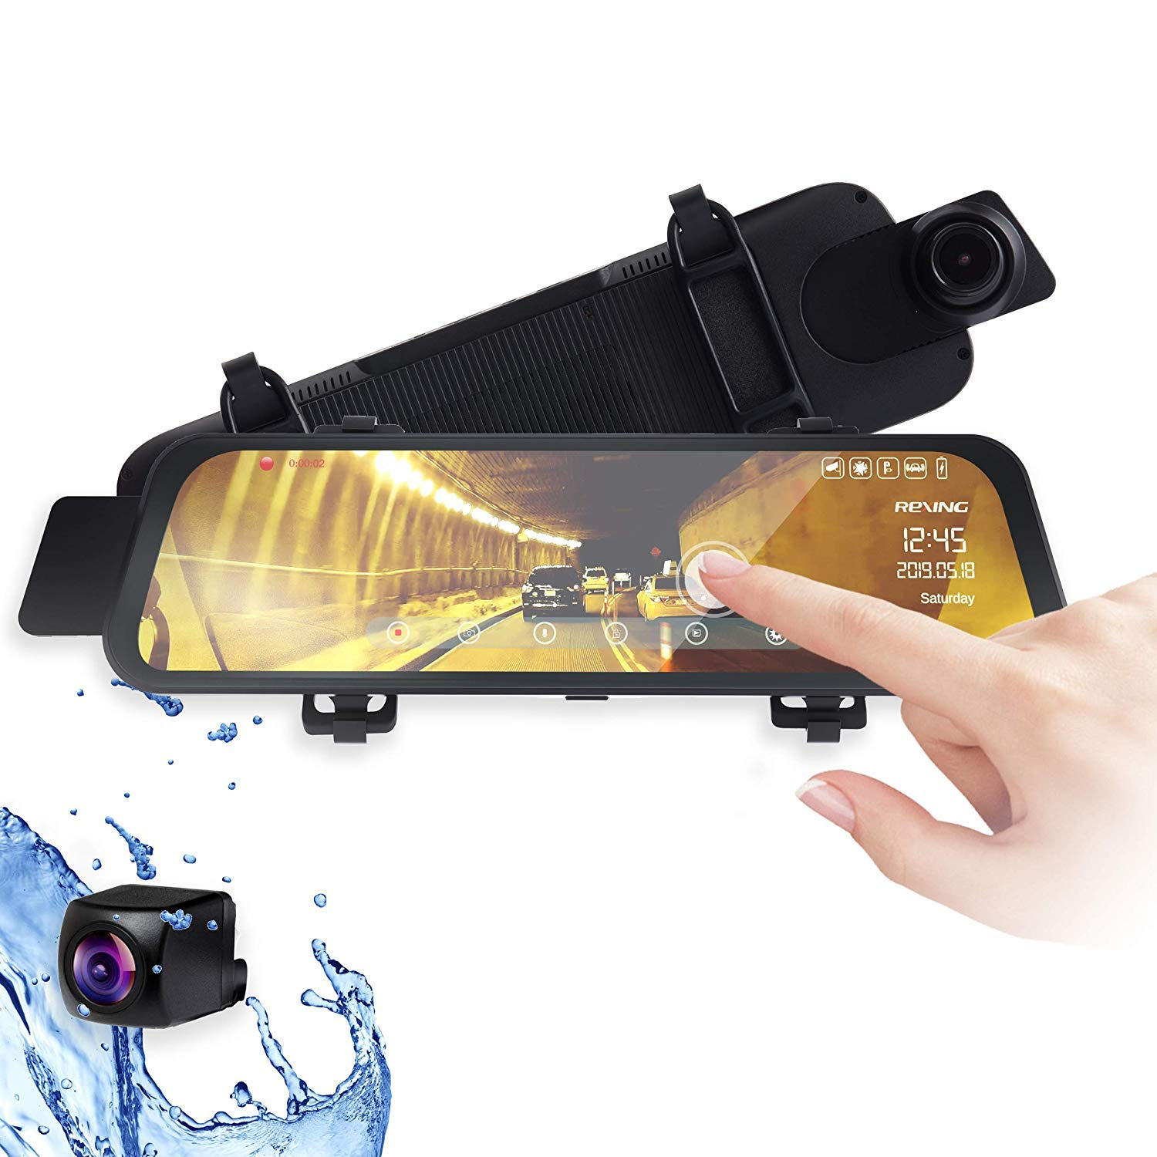
Rexing M1
$103.99
Front And Rear Dash Cam
1296P (Front) + 720P (Rear)
10” IPS Touch Screen
Auto-Reverse Backup Camera
G-Sensor and Parking Monitor*
Stream Media
Loop Recording
Waterproof Rear Camera
*Parking monitor feature required Rexing Hardwire Kit (sold separately) to be activated.

Slide 8
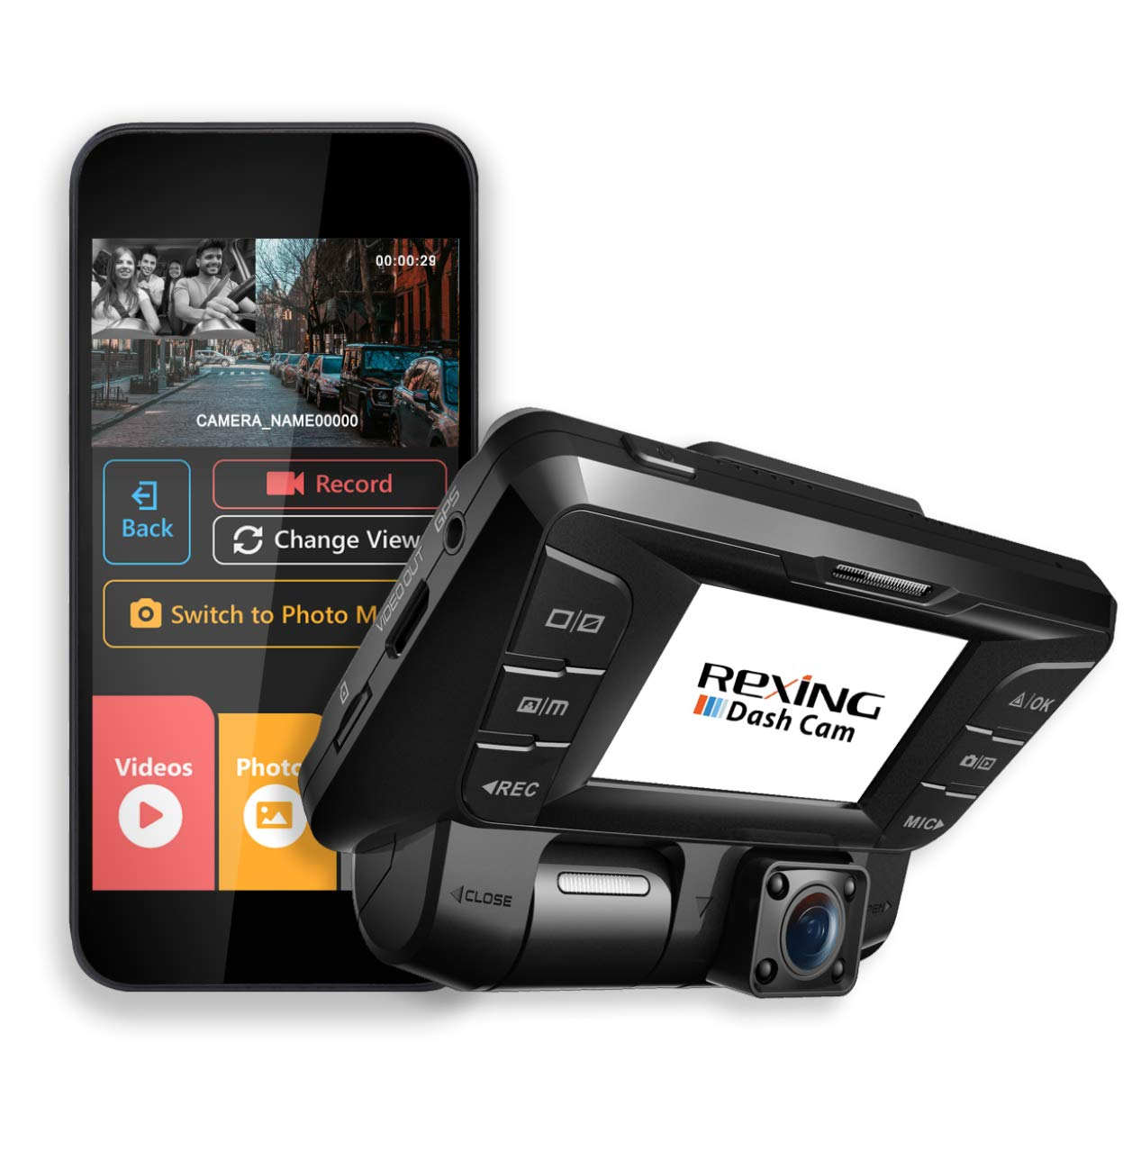
Rexing V2
$135.99
Front & Cabin Dash Cam
Full HD 1080P Resolution
2.4” LCD Screen
170° Wide Angle
G-Sensor and Parking Monitor*
Wi-Fi Connectivity
Loop Recording
Infrared Night Vision
*Parking monitor feature required Rexing Hardwire Kit (sold separately) to be activated.

Slide 9
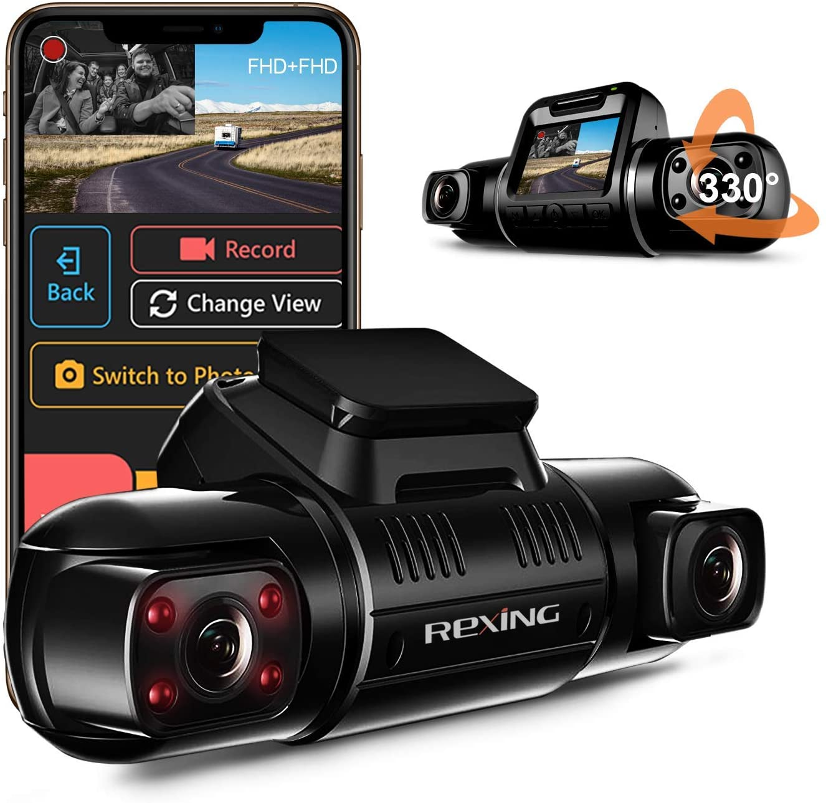
Rexing V2 Pro
$143.99
Front & Cabin Dash Cam
Full HD 1080P Resolution
2.7” LCD Screen
Supercapacitor
G-Sensor & Parking Monitor*
Wi-Fi Connect
Loop Recording
Infrared Night Vision
*Parking monitor feature required Rexing Smart Hardwire Kit (sold separately) to be activated.

Slide 10
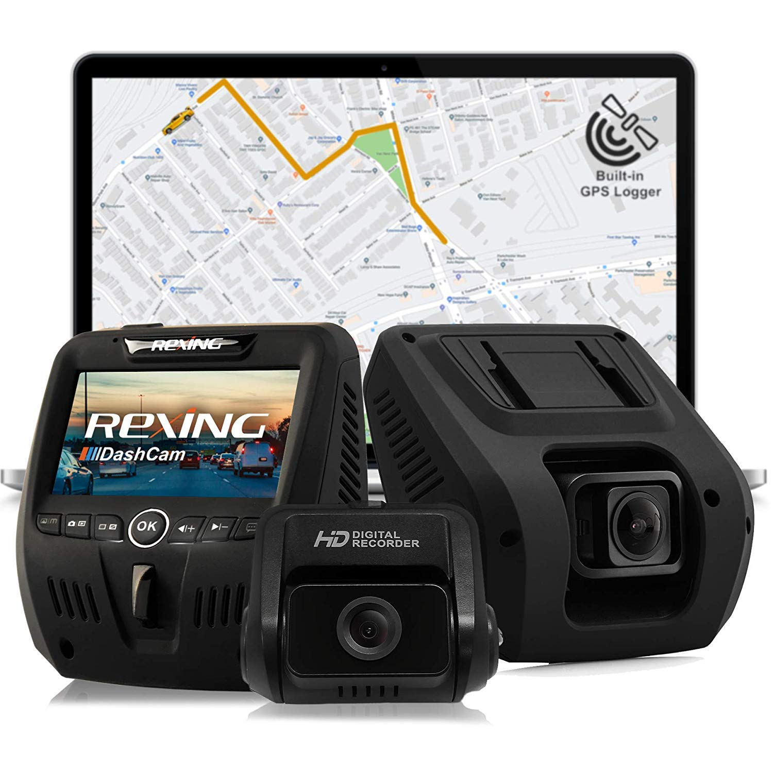
Rexing V1LG
$135.99
Front & Rear Dash Cam
Full HD 1080P Resolution
2.7” LCD Screen
170° Wide Angle
G-Sensor
Parking Monitor*
Loop Recording
Built-in GPS
*Parking monitor feature required Rexing Hardwire Kit (sold separately) to be activated.

Slide 11
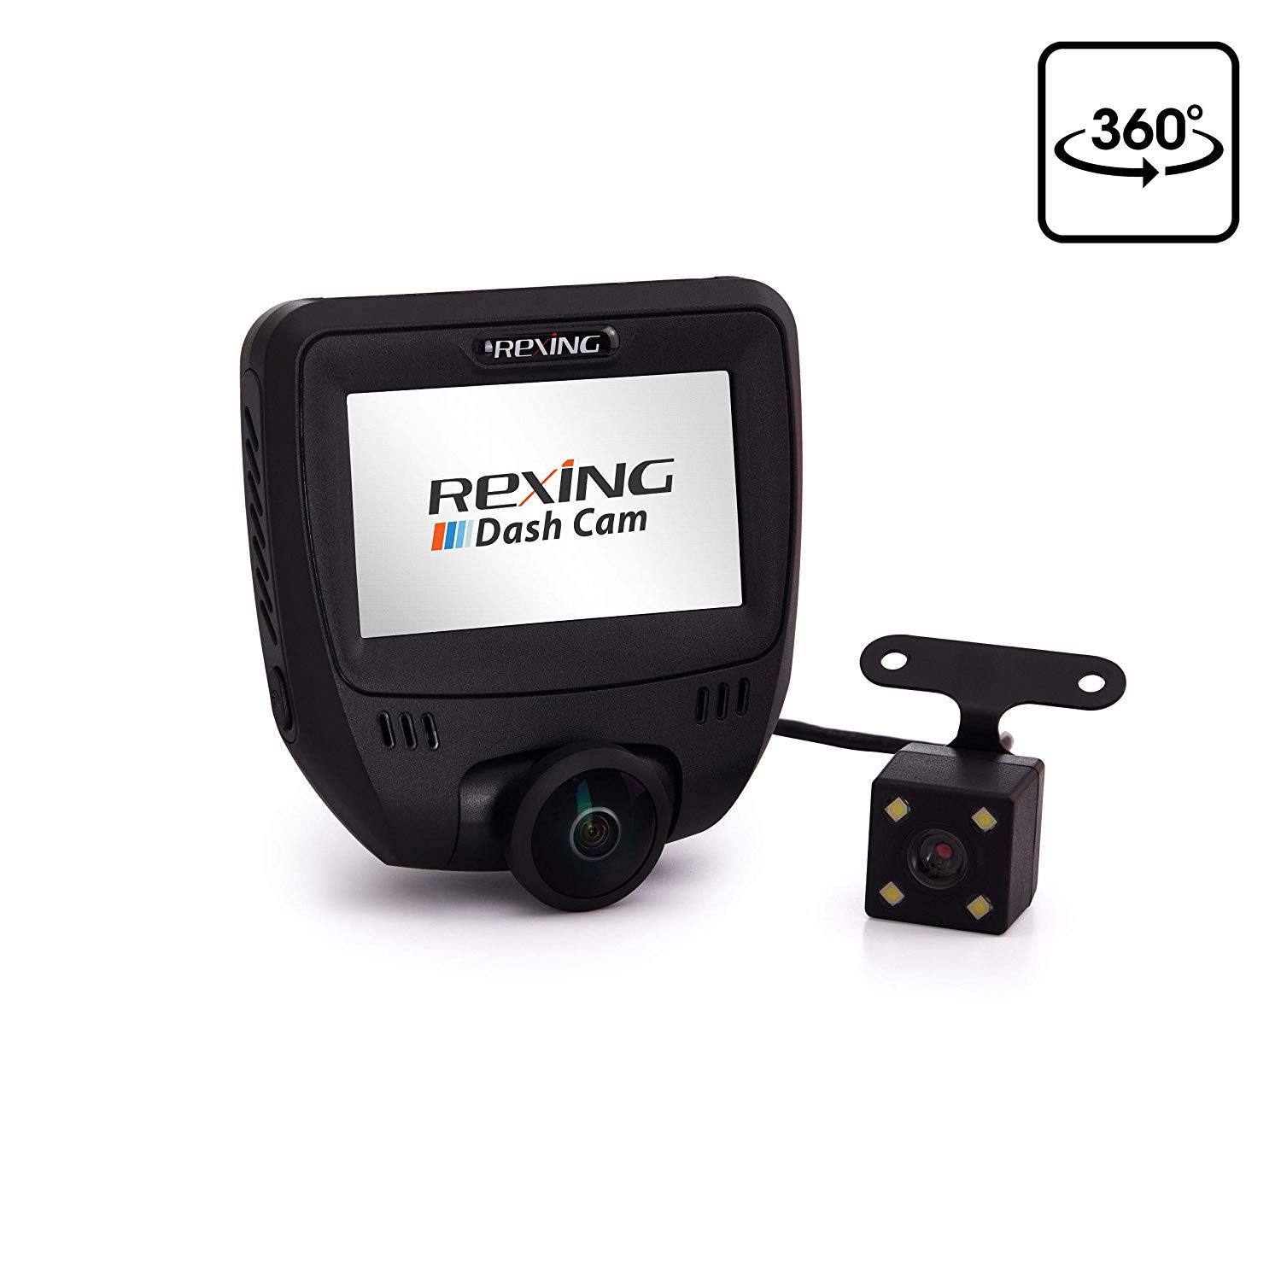
Rexing V360
$135.99
Front & Cabin Dash Cam
1440 x 1440 Resolution
3” IPS Touch Screen
360° Wide Angle
G-Sensor
WDR
Loop Recording
Auto-Reverse Backup Camera

Slide 12
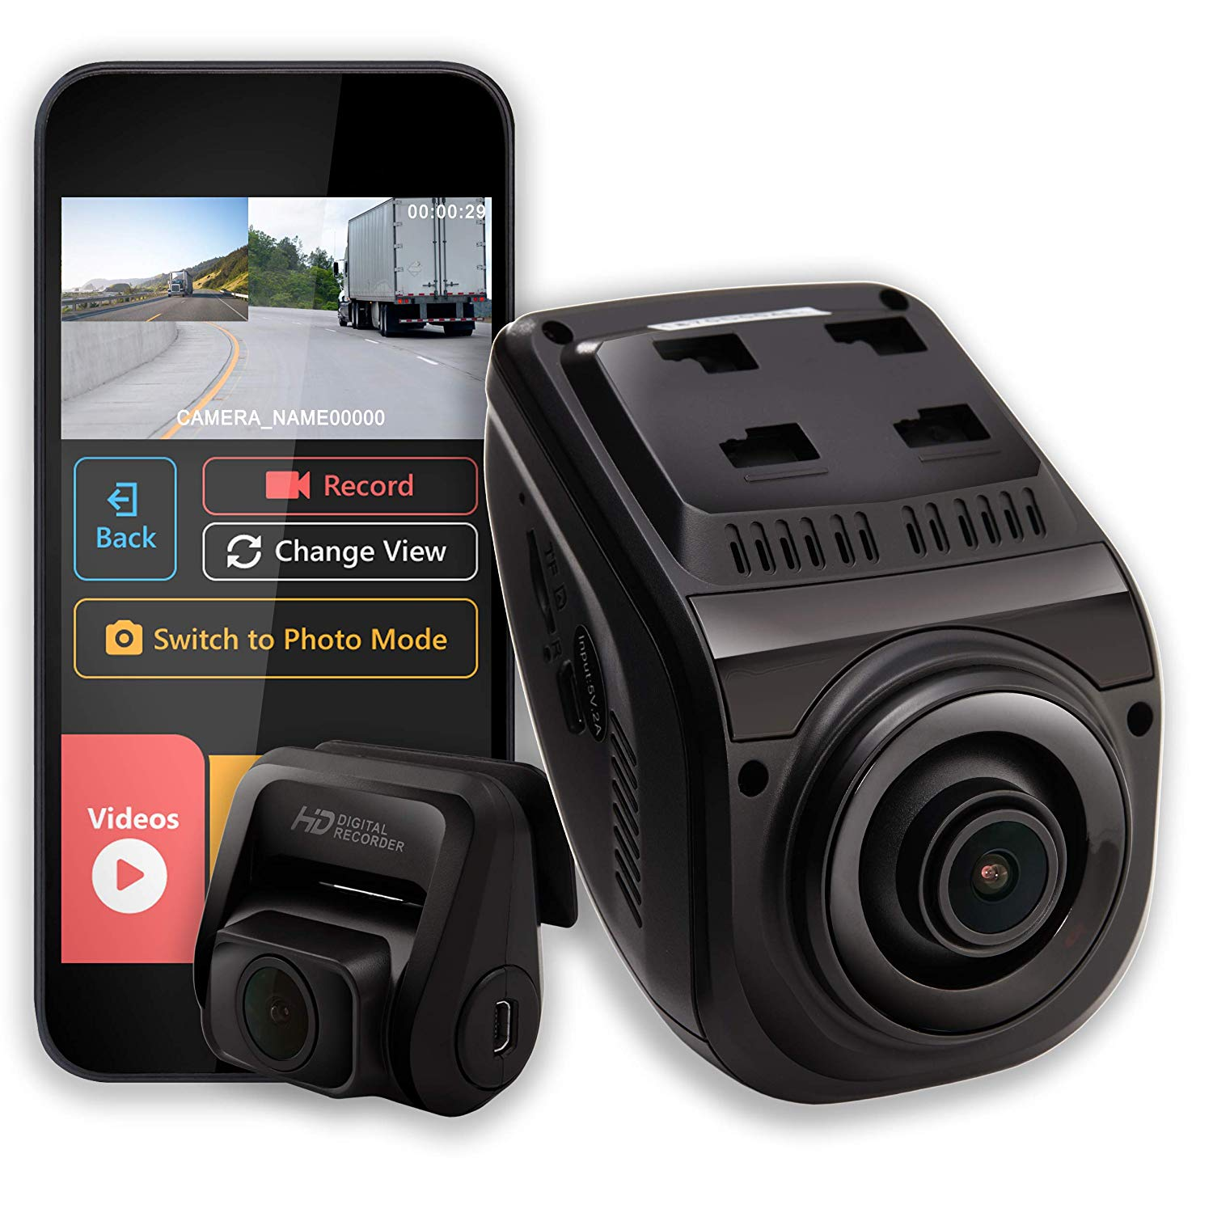
Rexing V1P 3rd Gen
$143.99
Front & Rear Dash Cam
Full HD 1080P Resolution
2.4” LCD Screen
170° Wide Angle
Supercapacitor
G-Sensor & Parking Monitor*
Wi-Fi Connectivity
Loop Recording
*Parking monitor feature required Rexing Smart Hardwire Kit (sold separately) to be activated.

Slide 13
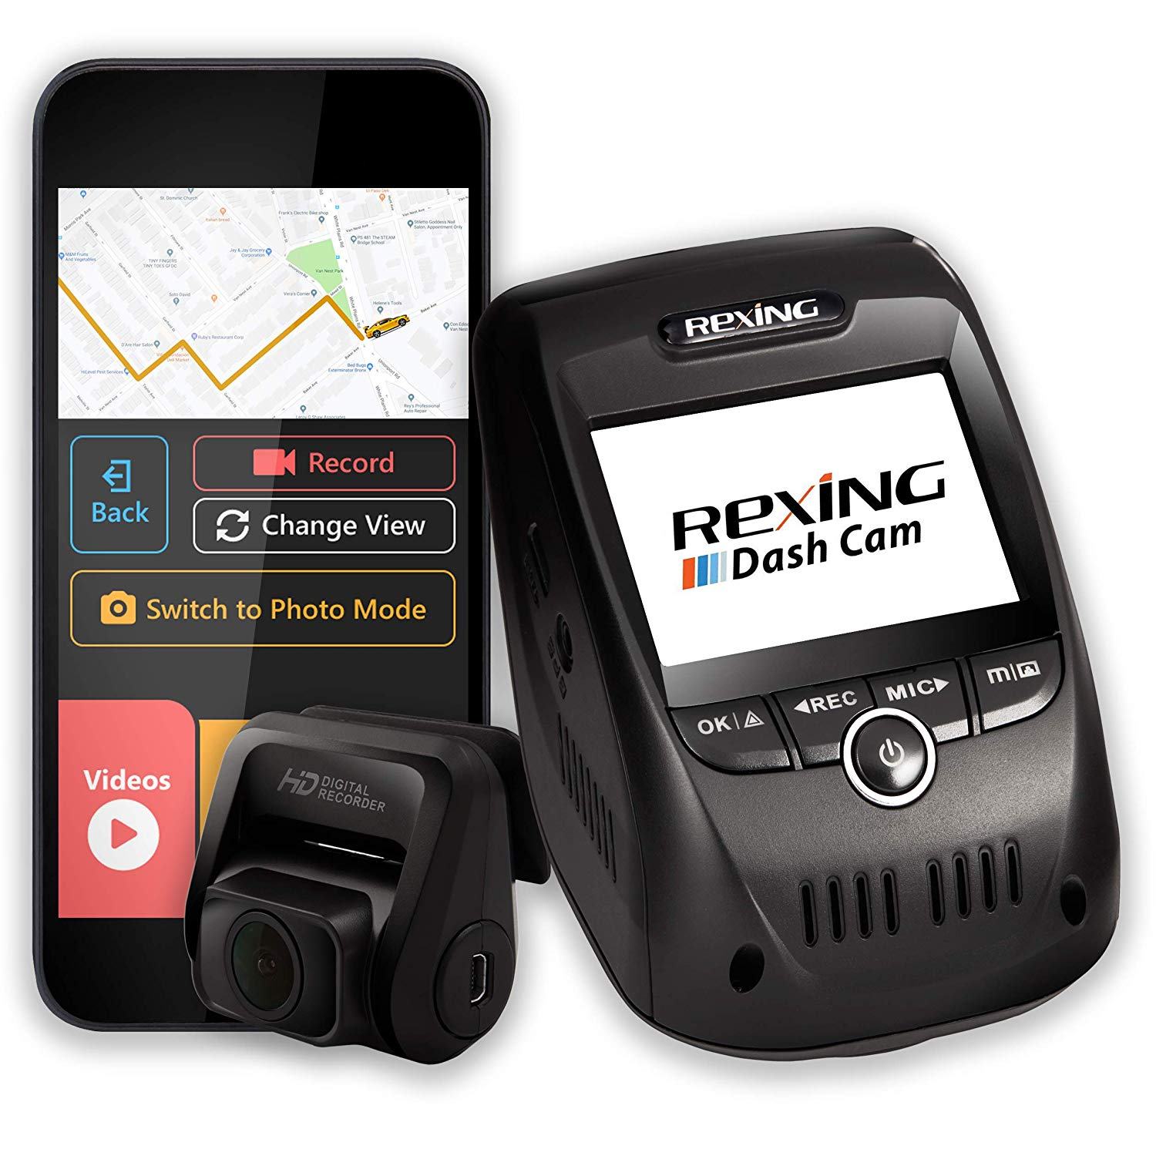
Rexing V1P Pro
$159.99
Front & Rear Dash Cam
Full HD 1080P Resolution
2.4” LCD Screen
Supercapacitor
G-Sensor & Parking Monitor*
Wi-Fi Connectivity
Loop Recording
Built-in GPS
*Parking monitor feature required Rexing Smart Hardwire Kit (sold separately) to be activated.

Slide 14
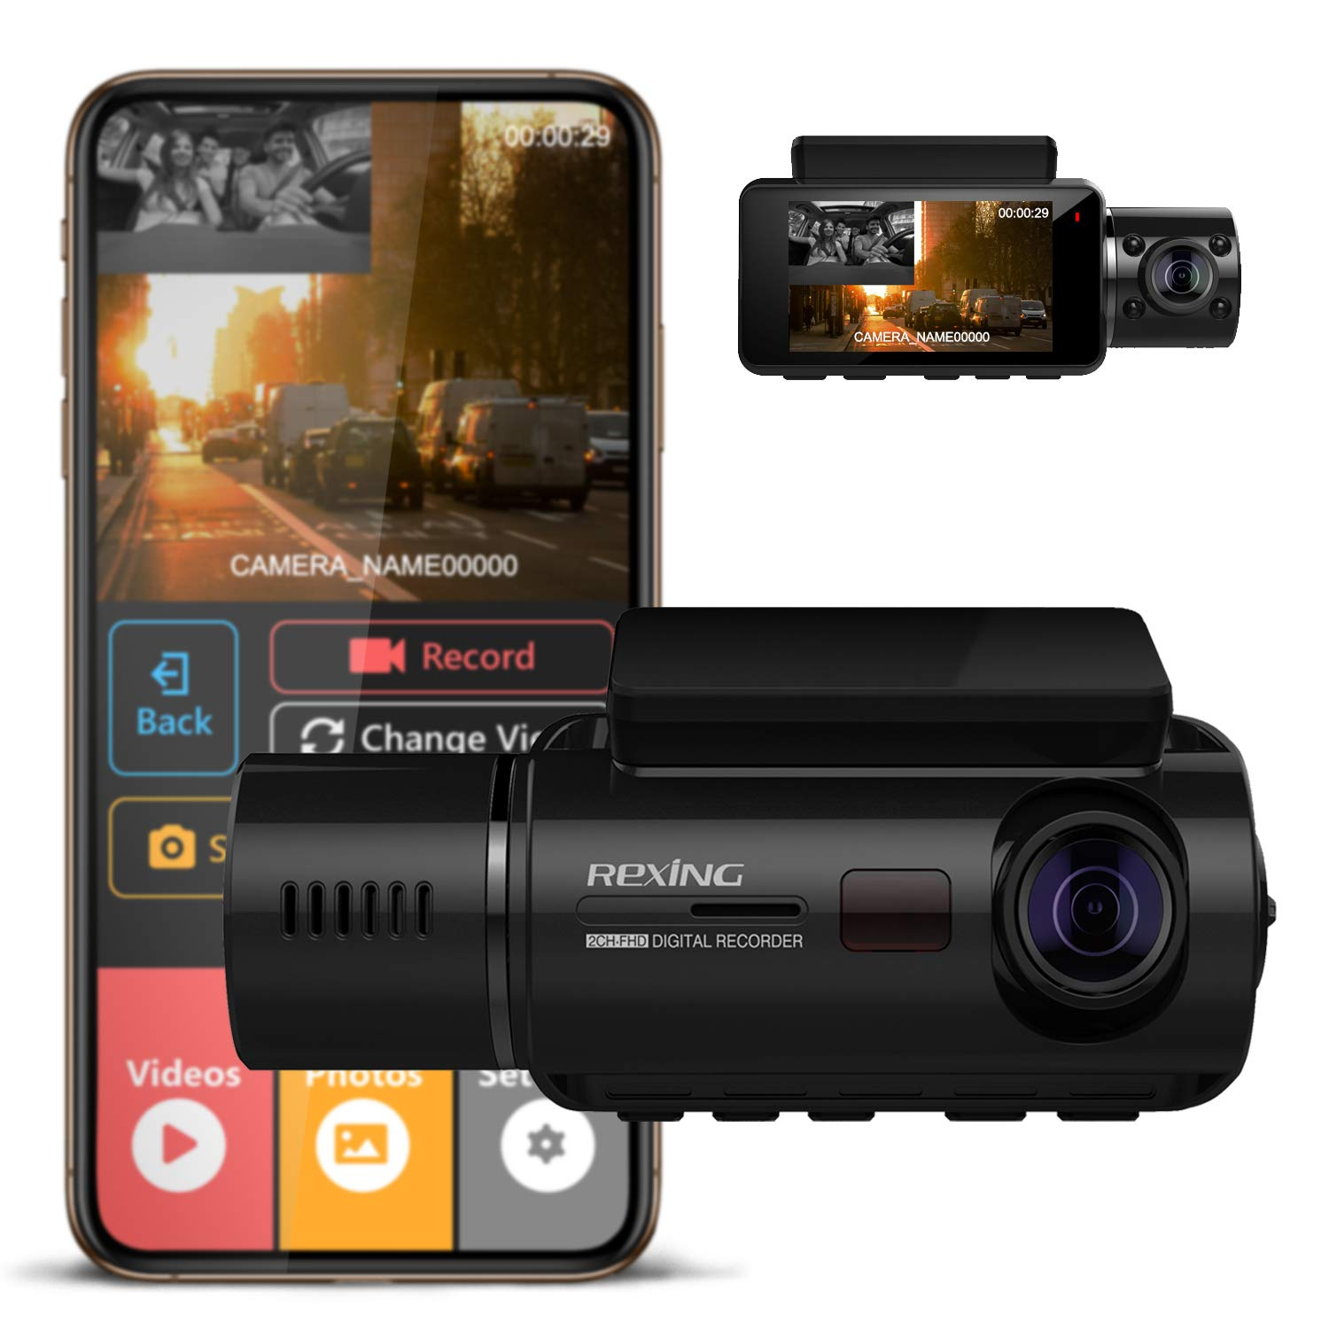
Rexing V3 Basic
$143.99
Front & Cabin Dash Cam
Full HD 1080P Resolution
2.7” LCD Screen
Supercapacitor
G-Sensor & Parking Monitor*
Wi-Fi Connectivity
Loop Recording
Infrared Night Vision
*Parking monitor feature required Rexing Smart Hardwire Kit (sold separately) to be activated.

Slide 15
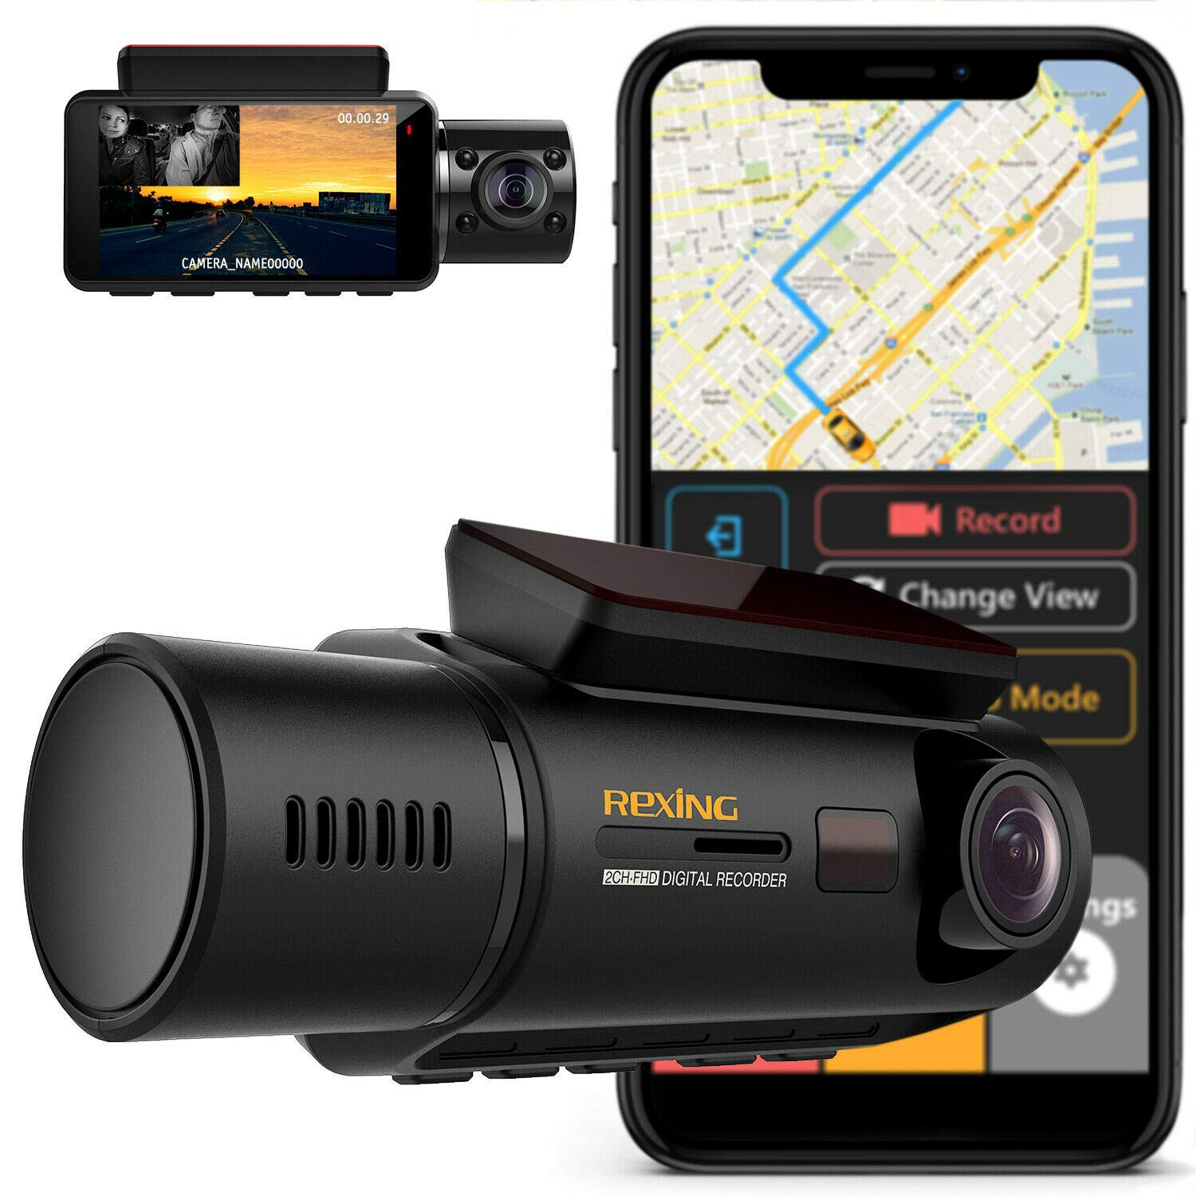
Rexing V3
$159.99
Front & Cabin Dash Cam
Full HD 1080P Resolution
2.7” LCD Screen
Supercapacitor
G-Sensor & Parking Monitor*
Wi-Fi Connectivity
Loop Recording
Built-in GPS
*Parking monitor feature required Rexing Smart Hardwire Kit (sold separately) to be activated.

Slide 16
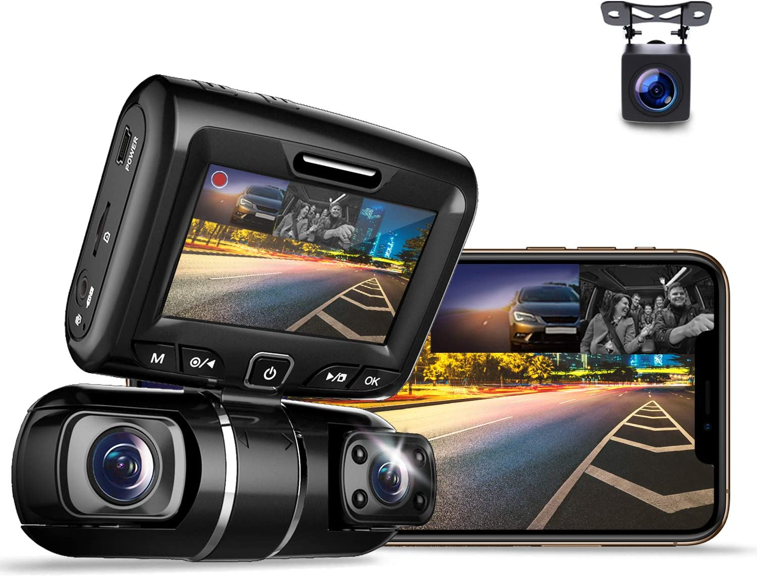
Rexing S1
$175.99
Front, Cabin & Rear 3-Channel Dash Cam
1080P+720p+720p Resolution
2” LCD Screen
Supercapacitor
G-Sensor & Parking Monitor*
Wi-Fi Connectivity
Loop Recording
Infrared Night Vision
*Parking monitor feature required Rexing Smart Hardwire Kit (sold separately) to be activated.
*Parking monitor feature required Rexing Smart Hardwire Kit (sold separately) to be activated.

Slide 17
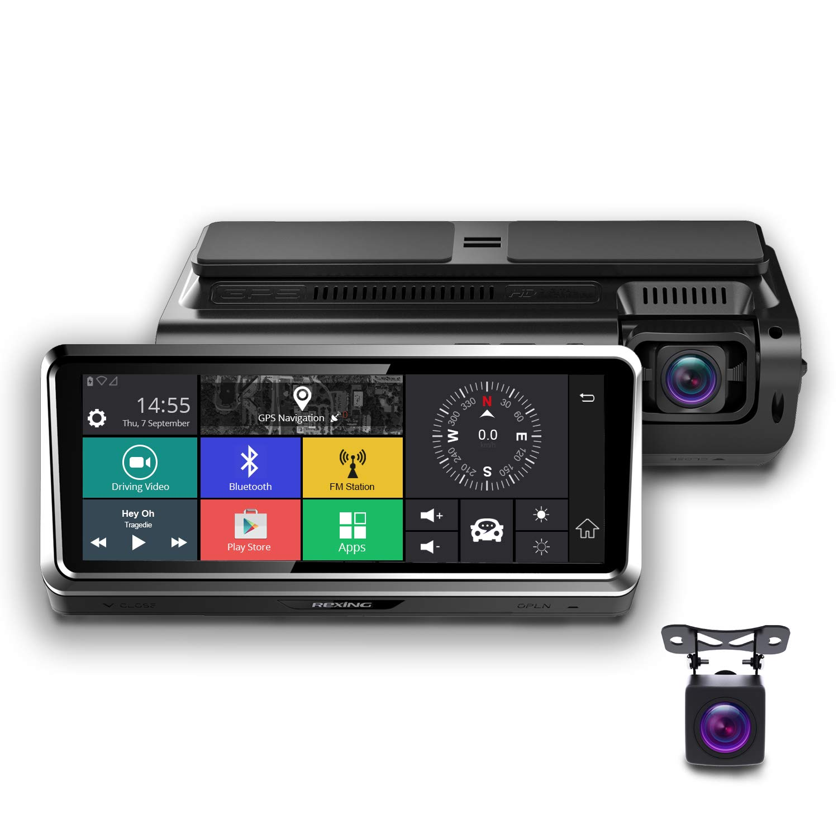
Rexing S800
$279.99
Front & Rear Dash Cam
Full HD 1080P + VGA
7” IPS Touch Screen
G-sensor & Parking Monitor
Wi-Fi Connectivity
Remote Monitoring
Built-in GPS
1-Year Data Plan Included (US ONLY)

Slide 18
Feature Comparison
www.rexingusa.com
18
 | Type | Max Resolution | Built-in Wi-Fi | GPS Logger | Supercapacitor | G-sensor | Parking Monitor | Loop Recording
V1 Basic | Front | 1080P | N | Optional | N | Y | Y | Y
V1-4K | Front | 2160P | Y | Optional | Y | Y | Y | Y
V1P | Front & Rear | 1080P | Y | Optional | Y | Y | Y | Y
M1 | Front & Rear | 1296P+720P | N | N | N | Y | Y | Y
V2 | Front & Cabin | 1080P+1080P | Y | Optional | N | Y | Y | Y
V2 Pro | Front & Cabin | 1080P+1080P | Y | Optional | N | Y | Y | Y
V1LG | Front & Rear | 1080P+720P | N | Y | N | Y | Y | Y
V360 | Front & Cabin | 1440X1440 | N | Optional | N | Y | Y | Y
V3 Basic | Front & Cabin | 1080P | Y | Optional | Y | Y | Y | Y
V3 | Front & Cabin | 1080P | Y | Optional | Y | Y | Y | Y
V1P 3rd Gen | Front & Rear | 1080P+1080P | Y | Optional | Y | Y | Y | Y
V1P Pro | Front & Rear | 1080P+1080P | Y | Y | Y | Y | Y | Y
S1 | Front, Cabin & Rear | 1080P+720P+ 720P | Y | Optional | Y | Y | Y | Y
S800 | Front & Rear | 1080P+VGA | Y | Y | N | Y | Y | Y

Slide 19
Wholesale Price List
Trail Cams & Body Cams

Slide 20
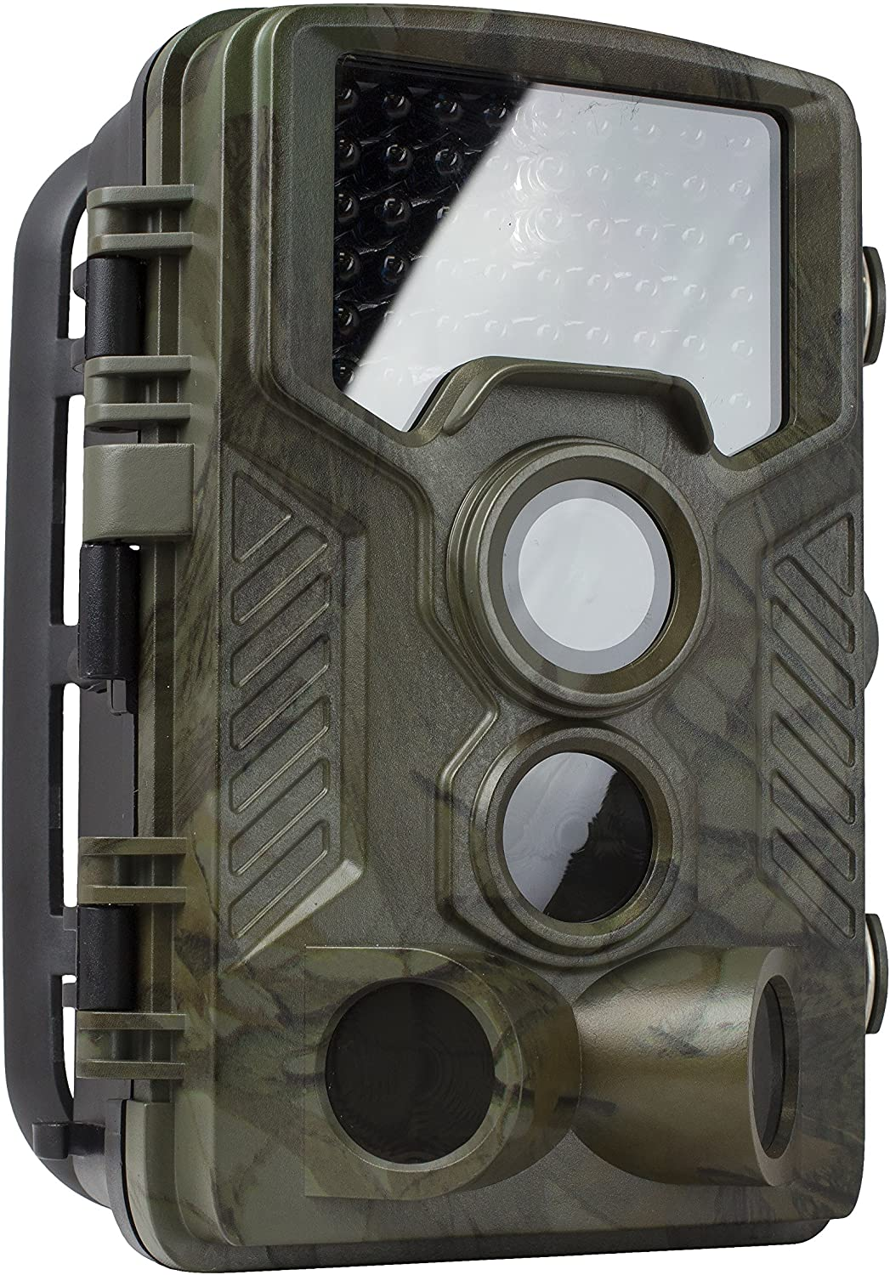
Rexing H1
$79.99
HD 16MP Trail Camera
Full HD 1080P
2.4” Built-in LCD Display
Motion Detection
Infrared Night Vision
Low Power Consumption
IP66 Waterproof
Supports MICRO SD cards up to 32GB (not included)

Slide 21
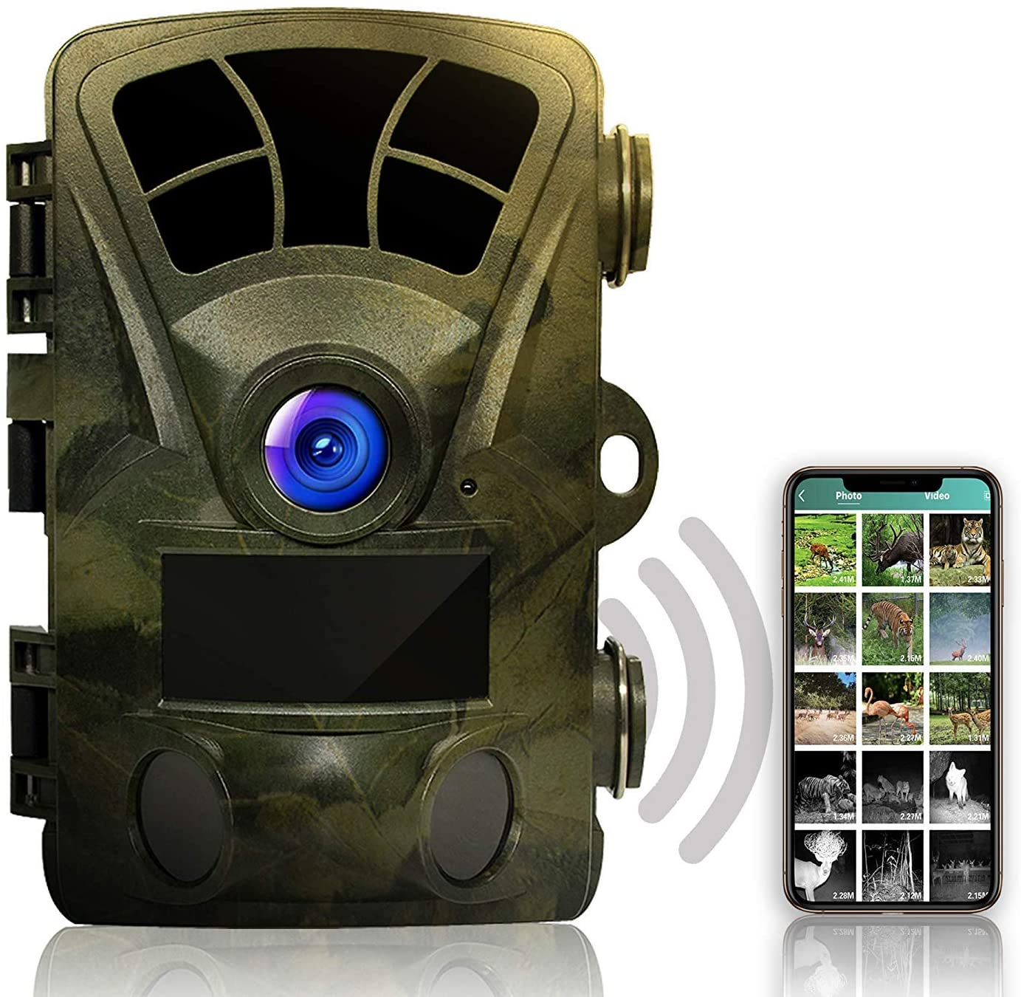
Rexing H2
$159.99
UHD Trail Camera
4K 2160P
2.4” Built-in LCD Display
Motion Detection
Ultra Night Vision
Wi-Fi Connect
IP66 Waterproof
Supports MICRO SD cards up to 512GB (not included)

Slide 22
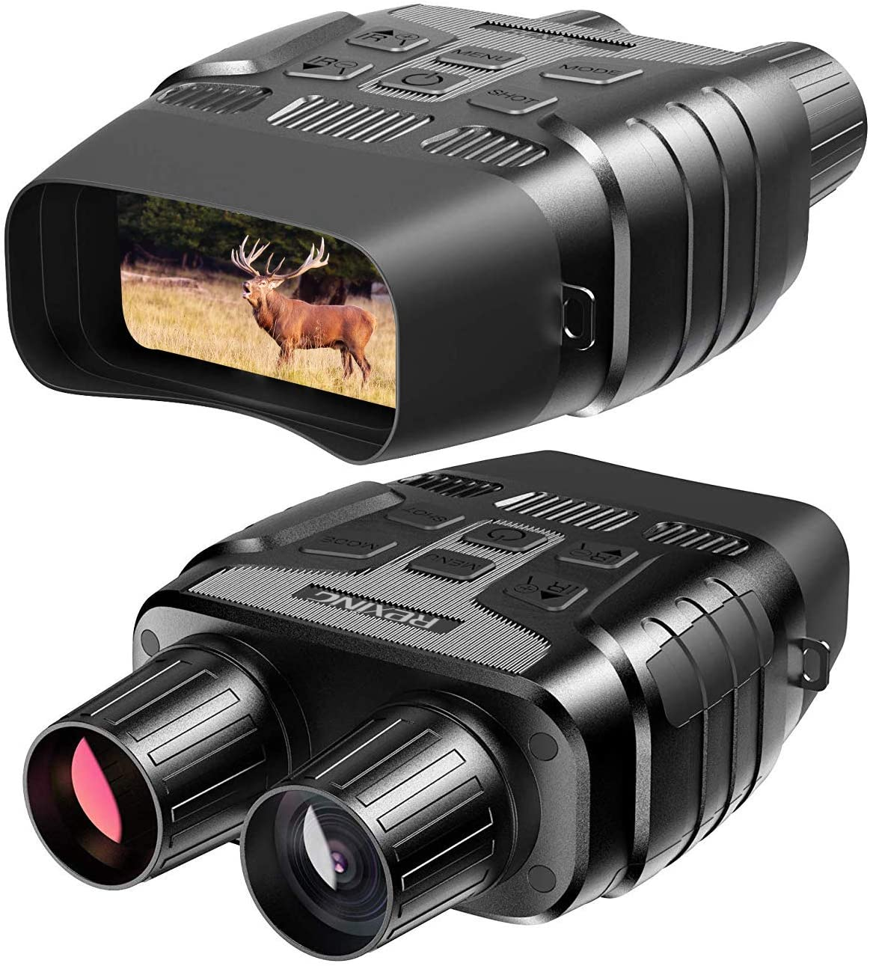
Rexing B1
$159.99
Digital Binoculars
10x Optical Zoom and 4x Digital Zoom
2.31” Built-in LCD Display
Photo and Video Mode
Infrared Night Vision
Low Power Consumption
IP56 Waterproof
Supports MICRO SD cards up to 32GB (not included)

Slide 23
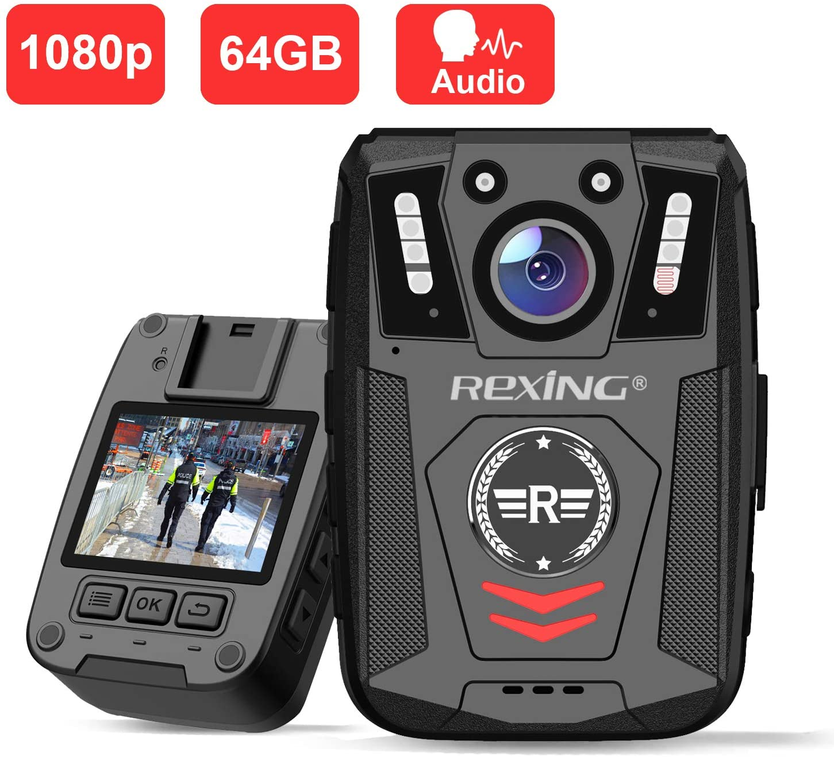
Rexing P1
$103.99
Body Wore Camera
Full HD 1080P
Built-in 64GB Memory
2” LCD Screen
Infrared Night Vision
Loop Recording
IP67 Waterproof and Shockproof
170° Ultra Wide Angle

Slide 24
Wholesale Price List
Accessories
Please contact us for pricing

